Slide 1
App center
week 1

Slide 2
Contents
01
02
Basic things of a server
Methods to develop a server

Slide 3
01
Basic things of a server
What is a server?
The overall picture of how it works

Slide 4

What is a server?
A server is a computer that provides a service to other programs called “clients”. -> What kind of computer can be a server?
A server is reached either via its IP address or Domain Name Servers(its role?)

Slide 5
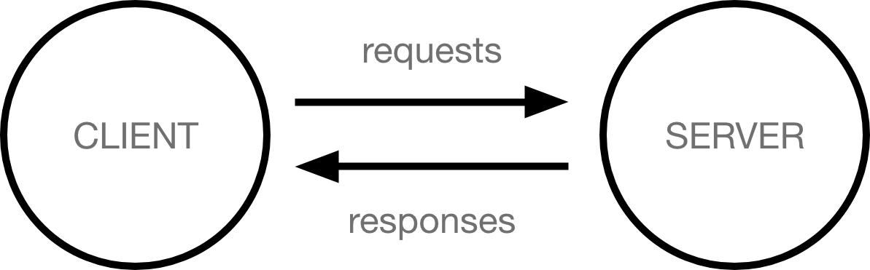
The structure of a server
Servers usually run unattended without input or output devices.
The dominant operating system among server is Linux with
Windows Server also having a significant share.
Client–server systems are most frequently
implemented by the request–response model.
How does this works?
This architecture is called the client–server model.

Slide 6
02
Frameworks to develop a server
Node.js(express)
Python(Django)
Java(Spring)
PHP(Laravel)

Slide 7
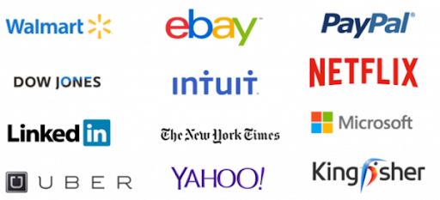
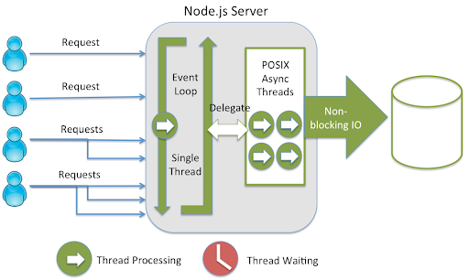
Node.js
Companies that use node.js
Netflix
Uber
LinkedIn
PayPal
Ebay
NASA
Features
Event-driven in a single thread event loop, which leads to fast speed
Convenience of full-stack development, because

Slide 8
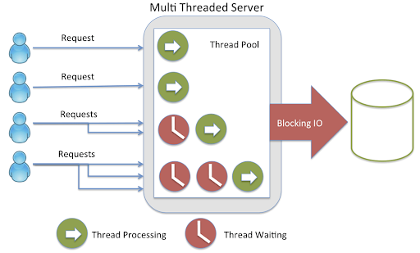
Spring
Companies that spring
Google
Microsoft
Naver
Amazon
Accenture
Intuit
Node.js VS Spring
A lot of I/O : go to Node.js
Fast computing : go to Spring
Features
multi-threading which makes intensive computing faster
due to I/O

Slide 9
Django
Companies that spring
Features
Excellent Documentation (one of the main reasons to use Django)
Rapid development (The main feature of python)
Instagram
Youtube
Dropbox
Mozilla
Spotify
Pinterest
Disqus
Bitbucket Eventbrite

